Slide 1

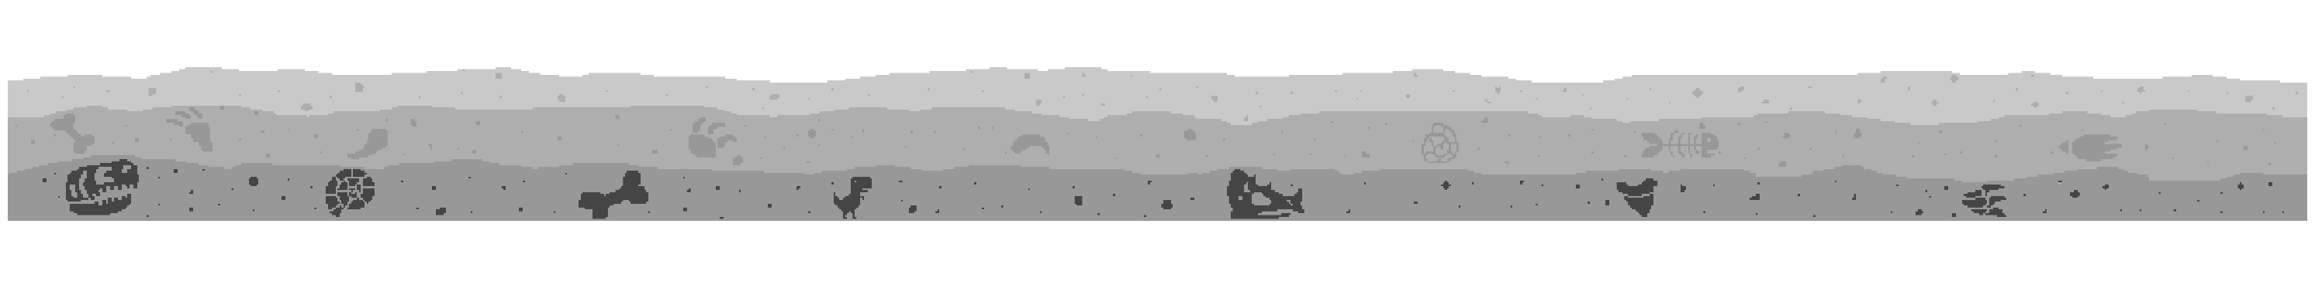
DinoRun GX

Slide 2
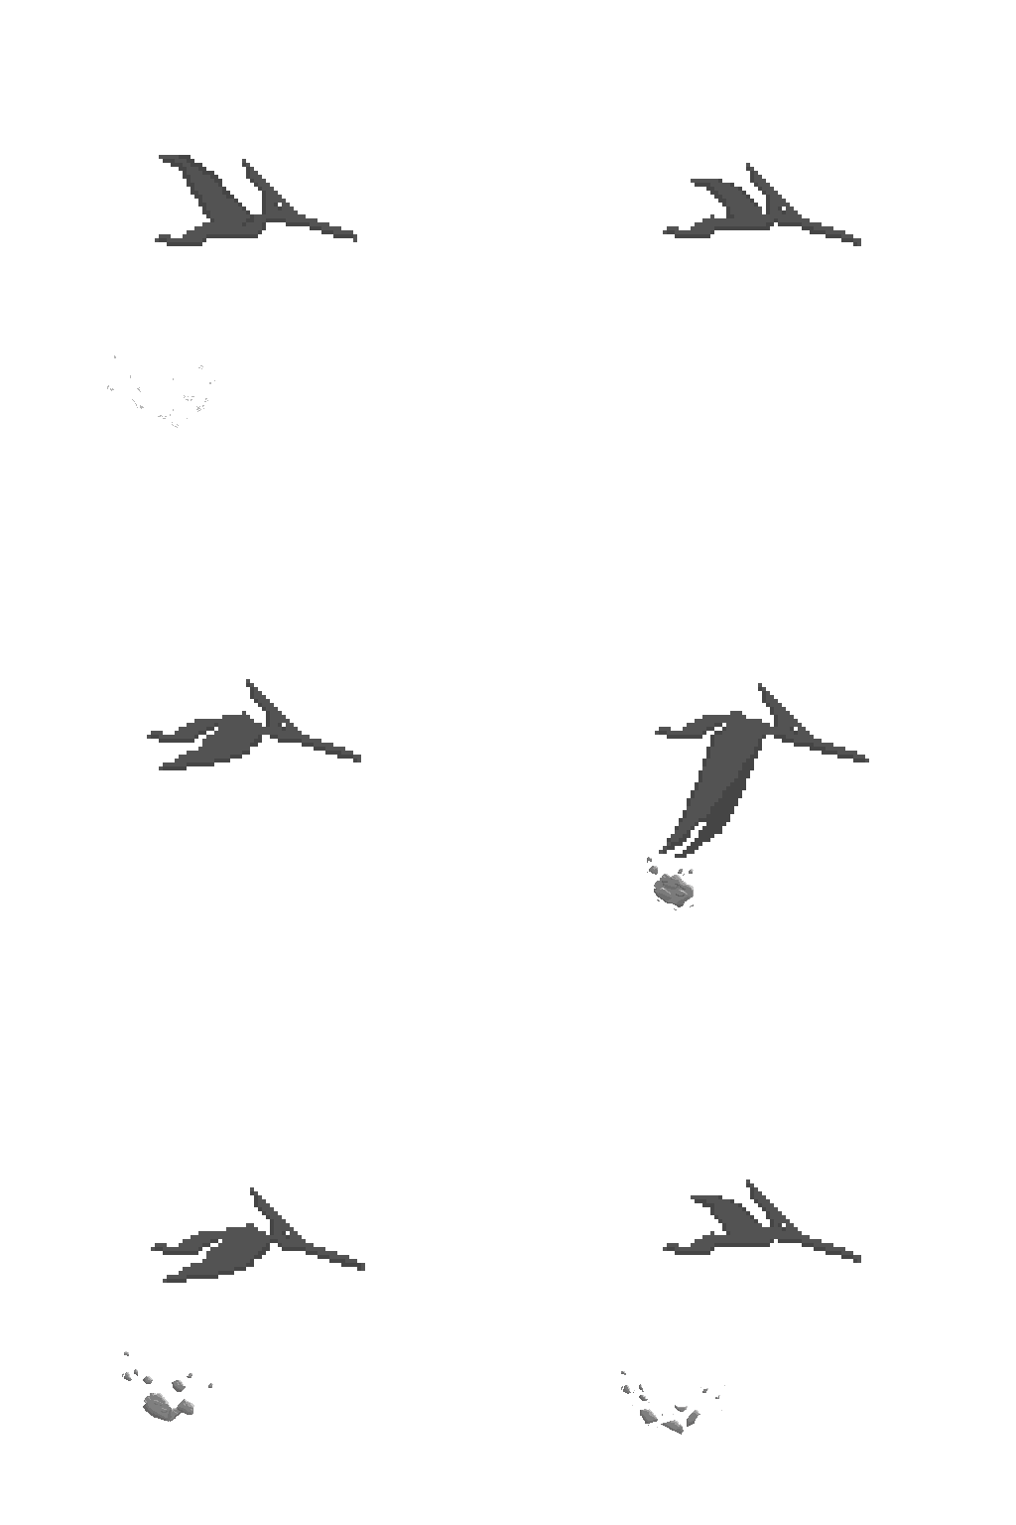
Team members
Nathan Vandevoort – Director
Cam gibb –Producer
Natalia perez –Art lead
Alex Dzius –Tech lead
Nick Erb –Design lead
Isabella king –Sound Lead

Slide 3




Trex

Slide 4
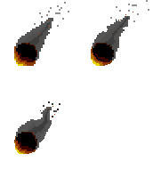

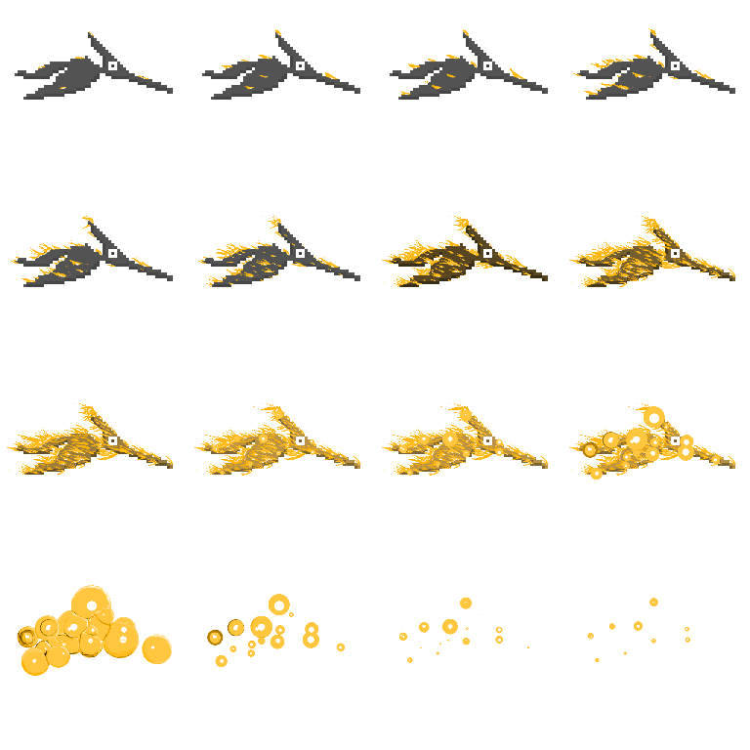
Pterodactyl

Slide 5
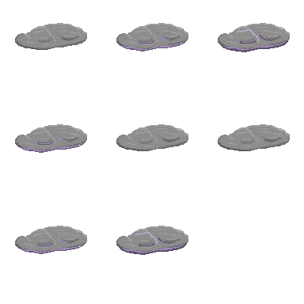
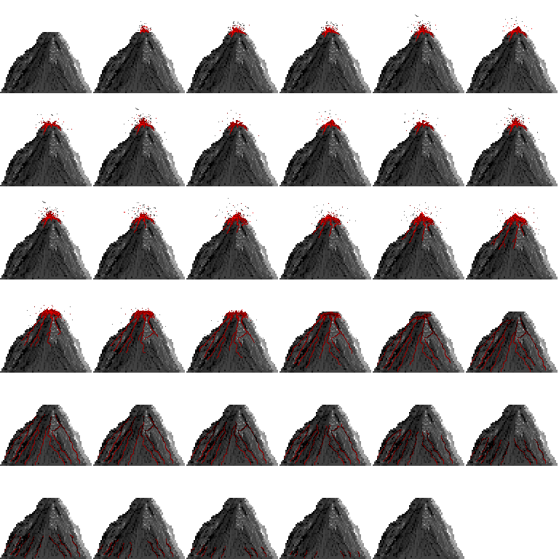
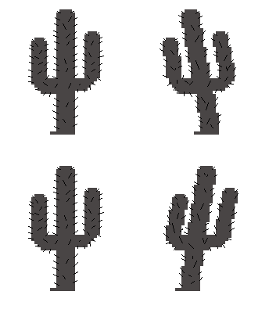
Background

